Slide 1
Network-Accelerator Co-Design for Dynamic Inference of Natural Language Processing
宋玉红
2020.08.28

Slide 2
Ours
Motivation:
Search pruning pattern for different energy on mobile devices
Contributions:
Pre-compress for shrinking search space, we can extract important pattern from pre-compression model
Joint-training for storage reducing
Reinforcement learning for result searching, use both accuracy and time consumption as reward

Slide 3
Experiment setting
Ours
Pre-compression model
Extract important pattern
Contrast experiment 1
Pre-compression model
Random generate pattern
Contrast experiment 2
Random column pruning
Extract important pattern
To prove effectiveness of our important pattern extraction method
To prove the effectiveness of pre-compression model

Slide 4
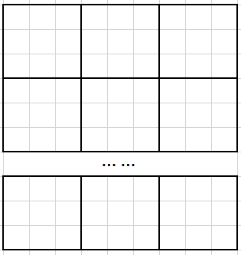
Importance pattern extraction methods
Ours
Pre-compression model –L2 norm
Importance pattern extraction methods
For every layer, we have n blocks.
For every time, we random sample m blocks.
In m blocks, we process pot-wise addition to get a importance matrix.
This process repeats k times.
We choose top-p importance matrix base on the sum of weight value.
According to energy level(pruning number=l), we choose top-l pixels to form a pattern in every importance matrix.

Slide 5
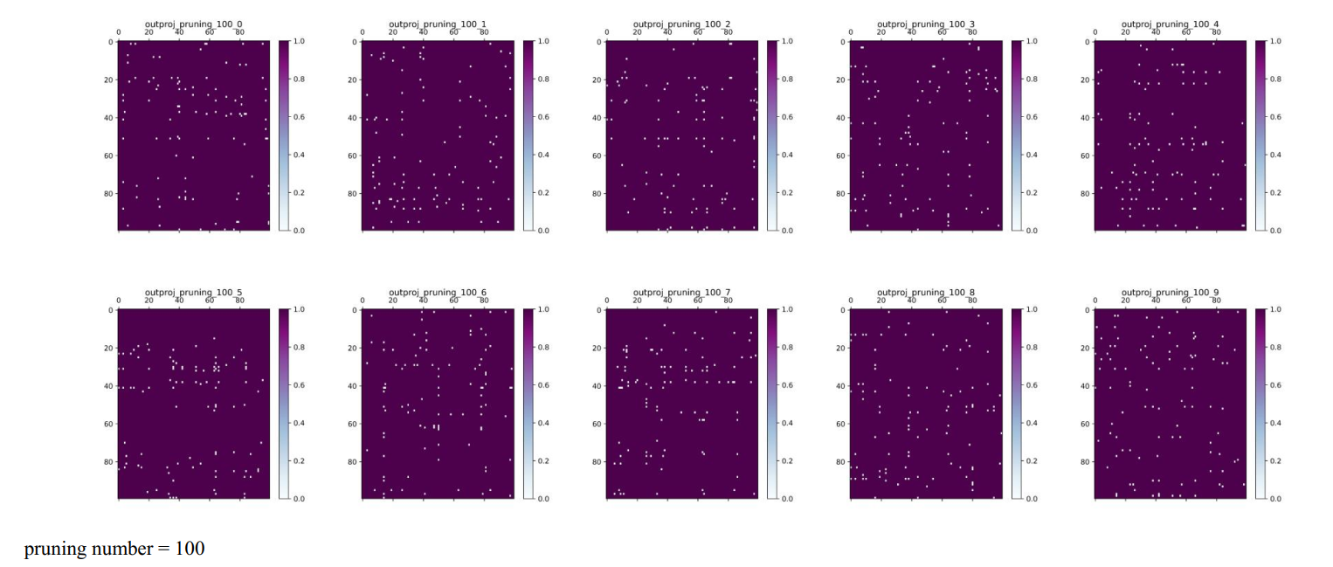
Experiment setting

Slide 6
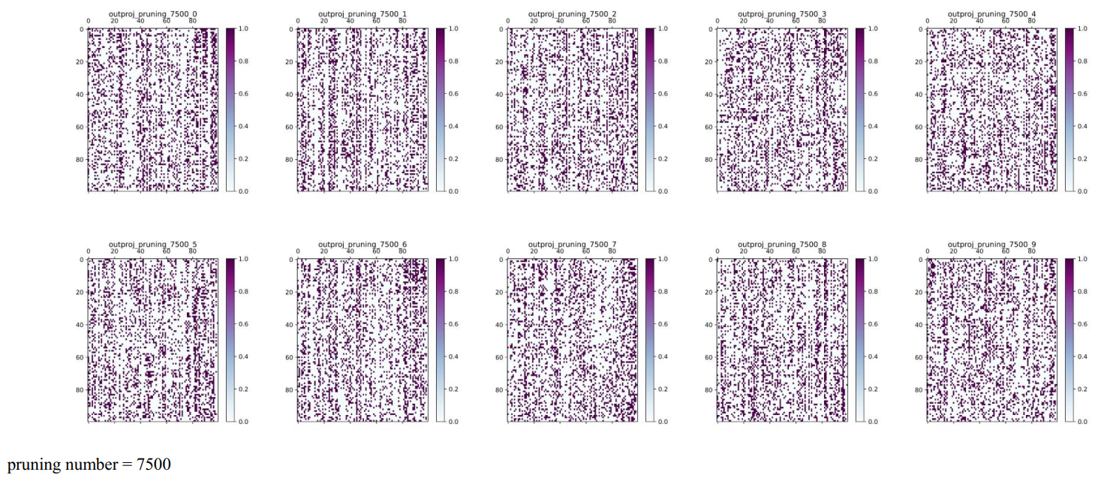
Importance pattern extraction methods

Slide 7
Experiment
Ours vs. Contrast experiment 1 (pruning number=7500)
Pre-compression model
accuracy = 96.81%, pruning rate = 64.2631%
Extract important pattern
accuracy = 95.27%, pruning rate = 83.7877%
Random generate pattern
accuracy = 94.93%, pruning rate = 84.3943%

Slide 8
Experiment
Ours vs. Contrast experiment 1 (pruning number=100,5000,7500)
Accuracy reduction is small
Pattern extraction method is better

Slide 9
Experiment
Ours vs. Contrast experiment 2 (pruning number=7500)
Pre-compression model
accuracy = 96.81%, pruning rate = 64.2631%
Extract important pattern
accuracy = 95.27%, pruning rate = 83.7877%
Random column pruning
accuracy = 96.36%, pruning rate = 64.2552%
Extract important pattern
accuracy = 93.17%, pruning rate = 84.2365%

Slide 10
Experiment
Pre-compression model is more effective

